Slide 1


PRESENTATION OF
SOFTWARE PROCESS AND MODELS
Jocy Andrade

Slide 2


What is a Software Process?
  Organized activities used to create software.
  It’s more than just coding.
  Helps a team go from idea ⟶ finished product!
  Helps to manage quality, time, cost and change!
  Creates a consistent way to develop a structure.

Slide 3





The 4 fundamental processes:
Specification: Decides what the software must do!
Development: This is when a Software Engineer designs and builds the system.
Validation: Testing to make sure the program works correctly.
Evolution: Making sure the program stays up to date after release by updating.
Example: For a shopping app this is how it would look -
Requirements ⟶ Design ⟶ Code ⟶ Test ⟶ Release ⟶ Upddate
Visual: Specification ⟶ Dev ⟶ Validation ⟶ Evolution

Slide 4


Software Process Models:
Integration & Configuration:
Waterfall:
Incremental:
  Work is able to move through it’s planned phases.
  This is a method best usedd when the requiremnts are stable.
  Software is delivered in smaller versions to make sure each step is working correctly.
  Feedback is given back more quickly which then influences later releases.
  This is when you bbuild a system using reusable software and components so it’ll never be outdated simply in need of upgrades.

Slide 5
Plan-Driven Vs. Agile:
Plan-Driven:
Agile:
  You need to have detailed planning before dev.
  All the documentation and schedules must be acccurate.
  This is also useful when predicatbility on multiple thing is important.
  These systems have a shorter development cycle.
  There is frequent customer feedback.
  There are also faster responses to any changing requirements from clients, Software engineers, and users.

Slide 6

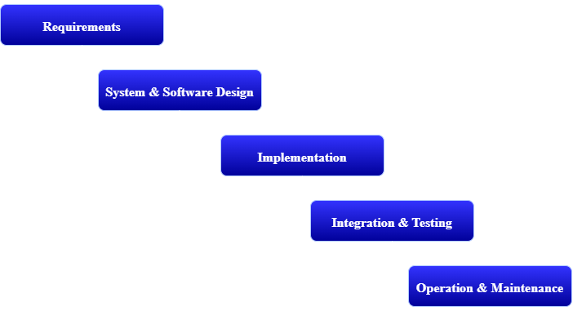
Waterfall Model/Process:
Major Phases:
  Requirements Analysis
  System/Software Design
  Implementation and Unit Testing
  Integration and System Testing
  Operation and Maintenance
    Each phase leads into the next
    Major planning happens before development
  It’s a plan-driven approach
  Documentation Records decisions
  Phases are generally completed before moving forward.
  Late requirement changes can be expensive

Slide 7
Waterfall: Pros VS. Cons
Pros:
Cons:
  Clear project structure
  Defined milestones & responsiblities
  Strong documentation
  Easier progress tracking
  Difficult to handle changing requirements
  Working software appears later
  Problems may be discovered late.
  Changes can require major reworks.
Waterfalls biggest weakness is its difficulty accommodating change once development is underway.

Slide 8
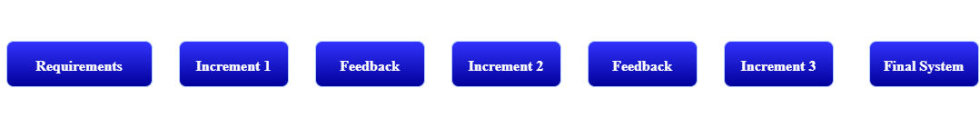
Incremental Process:
  Customers evaluate early versions of the software.
  Changes can be made between increments.
  High-priority features are able to be delivered first.
  This process can reduce the cost of any changing requirements.

Slide 9
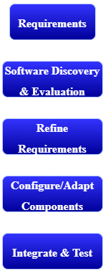

Integration and Configuration:
Reuse-Based Process:
  This method reuses existing software instead of starting from scratch
  May use components, frameworks, APIs & services.
  Existing software is evaluated for project needs.
  Requirements may change based on available components,
  Components are configured, adapted, & Integrated.
Pros:
Saves development time & resources.
Cons:
Existing components may not meet every requirement.

Slide 10
Complete Software Process:
Design & Implementation:
Specification:
Validation:
Evolution:
Main Idea:
  Identify requirements & constraints.
  Create architecture and write code.
  Test software against requirements.
  Fix, improve, and adapt after release.
  Development doesn’t end when version 1 is released.

Slide 11
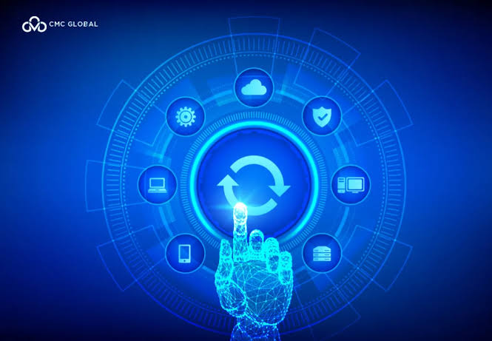
Why Software Changes:
  Customer needs evolve.
  New tech starts to become available as it advances.
  Bugs and security issues are discovered.
  Business or legal requirements change.
  Competitors & markets influence expectations.
Changes may affect:
  Cost
  Schedule
  Testing
  Documentation

Slide 12
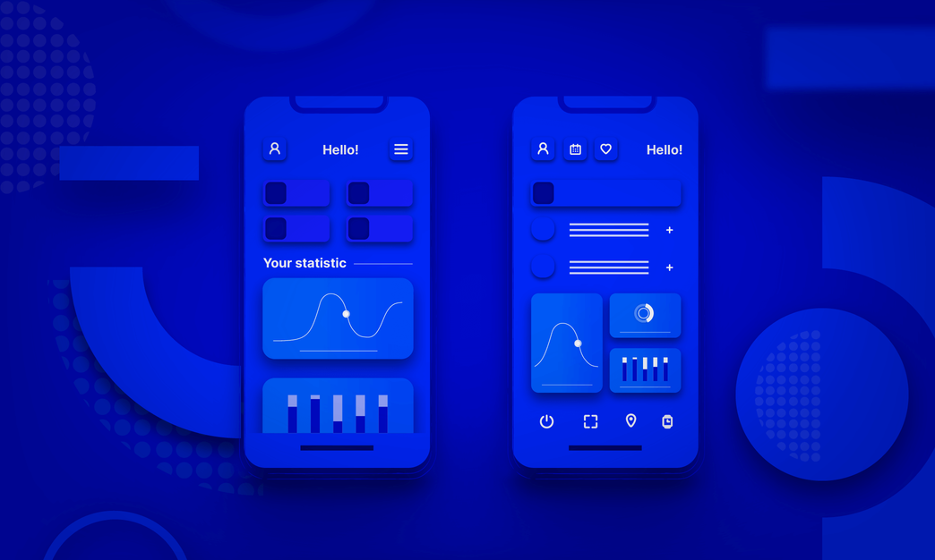
Prototyping:
  Creates an early version of an idea.
  Helps clarify unclear requirements.
  Allows designs to be evaluated early.
Incremental Delivery:
  Useful features delivered in stages.
  Customers receive value sooner.
  Feedback improves later releases.
  Reduces risk from changing requirements.
Prototyping & Incremental Delivery:

Slide 13
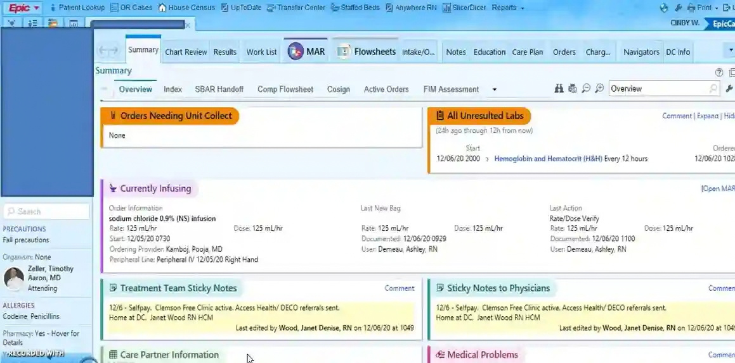
Real-World Application 1:
Example photo of System:
Company: Epic System
System: EpicCare Electronic Health Record.
  Used by healthcare organizations.
  Stores & manages patient health information.
  Supports clinical workflows
  Connects information across healthcare systems
  Helps clinicians coordinate patient care.
Epic reports extensive interoperability between healthcare organizations through systems such as Care Everywhere.

Slide 14
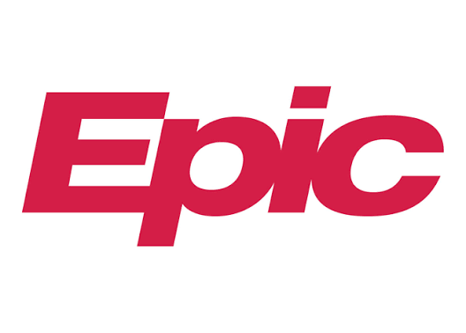
How Epic Software is Developed:
  Healthcare workflow influences requirements
  Quality teams observe real clinical environments.
  Software functionality & usability are tested.
  APIs support integration with other applications
  Sandbox environments support development/testing.
  Customer environments require additional testing.
  Software continues evolving through new releases.
Epic says its quality staff observes clinicians’ workflow in an actual healthcare environment. Its developer resources also describe sandbox testing, followed by customer-specific implementation, configuration, non-production testing, troubleshooting, and release.

Slide 15
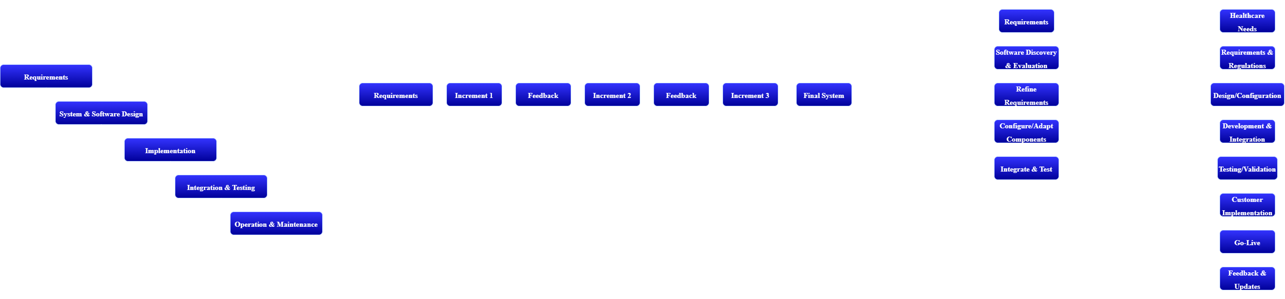

My Interpretation: Hybrid Agile and Waterfall Approach
EpicCare Process Model:
  Plan-Driven characteristics for safety & compliance
  Incremental evolution through new features/releases
  Integration with APIs & outside systems
  Extensive validation before deployment
On the right, you’ll see my interpretation of their system based on what I’ve researched.

Slide 16

Real-World Application 2:
Example photo of System:
Company: League of Legends
System: League of Legends
  Online multiplayer competitive game.
  Used by players around the world.
  Requires frequent content & software updates.
  Gameplay must remain stable and responsive.
Riot maintains a planned League patch Schedule throughout the year.

Slide 17

How League is Developed:
  Developers continuously create code & content.
  Automated tests identify defects.
  Continuous integration provides rapid feedback.
  Manual testing supplements automation.
  Test environments verify new builds.
  Updates are delivered through frequent patches.
  Player experience influences future improvements.
Riot has reported using continuous integration and extensive automated testing for League. Its engineering team described roughly 100,000 automated test cases per day and rapid feedback after code changes.

Slide 18
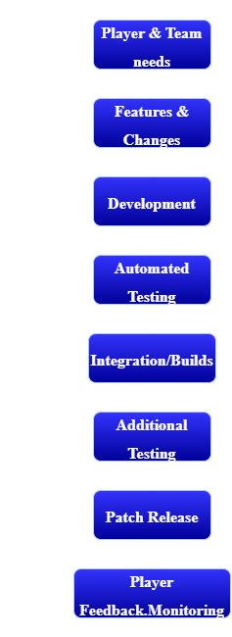
League of Legends Process Model:
Agile/Incremental Charateristics:
  Frequent changes
  Continuous testing
  Regular incremental releases
  Feedback loops support future updates
Riot has described a continuous-delivery pipeline that gradually increases test coverage before deployment. League also uses frequent scheduled patches.

Slide 19
Category | EpicCare EHR | League of Legends
Company | Epic Systems | Riot Games
Primary Users | Healthcare Organizations | Game Players
Approach | Hybrid | Agile/Incremental characteristics
Requirements | Clinical & regulatory needs | Gameplay and Player needs
Testing | Extensive validation | Automated + Manuel Testing
Deployment | Controlled implementation | Frequent patches
Updates | Ongoing releases | Regular updates
Feedback | Healthcare users | Players/development teams
EpicCare vs. League of Legends:

Slide 20
Process Comparison: EpicCare VS. LoL
EpicCare EHR | League of Legends
Safety is Critical | Speed & Responsiveness is Important
Strong documentation needed | Rapid feedback loops
Regulatory contraints | Frequently changing content
Clinical & regulatory needs | Gameplay and Player needs
Extensive integration | Continuous integration/testing
Controlled deployments | Frequent patches releases
Long-term evolution | Continuous game evolution

Slide 21
Choosing the Right model:
Waterfall works well when:
Agile/Incremental works well when:
  Requirements are stable.
  Strong documentation is required.
  Changes are expected to be limited.
  Planning/predictability are priorities.
  Requirements change frequently.
  Customer feedback is important.
  Early releases provide value.
  Rapid adaption is necessary.
Larger Projects:
  Often combine multiple process models.
Software process models aren’t mutually exclusive; large systems can use diffrent appraoches for diffrent portions of the projects.

Slide 22
Why do companies use diffrent processes?
  Every software project has diffrent needs.
  Safety may matter more than release speed.
  Requirements may be stable or constantly changing.
  Team size affects coordination.
  Regualtions may require additional validation.
  Customer expectations affect release frequency.
  Cost & risk influence development decisions.
In Conclusion:
  There is no single software process that works best for every project.
EpicCare and League illustrate this very well: healthcare software operates in an enviroment where clincical workflows, interoperability, testing, and regulatory standards are especially significant, while League operates with frequent code/content changes, automated testing, CI, and regular patches.

Slide 23
Thank you!

Slide 24
References:
  Epic Systems Corporation. (2026). Our software.
  Epic Systems Corporation. (n.d.). Developer resources.
  Epic Systems Corporation. (n.d.). Quality management. Epic Careers.
  Riot Games. (2016). Automated testing for League of Legends.
  Riot Games. (2016). Running an automated test pipeline for the League client update.
  Riot Games. (2026). Patch schedule – League of Legends.
  Sommerville, I. (2015). Software engineering (10th ed.). Pearson.

